Slide 1
Inscribe Your Organization’s Legacy on The Rock
University Archives Info Session

Slide 2
What is the Archives?
Located in 315 Bailey Library
Archivist, staff, and student employees
Judy Silva, archivist
Kevin McLatchy and Jared Negley, technicians
Four student employees
Repository to permanently store and preserve historical record of SRU’s “people, programs, policies, facilities, activities, and achievements.”

Slide 3
The Archives is the institutional memory of Slippery Rock University. It permanently houses inactive records of the University and its students.

Slide 4
Who uses the Archives?
Alumni
Relive the “good old days”
Archives Open House, Homecoming weekend
Researchers
Local history
Trends in Student Life
Historic events at SRU

Slide 5
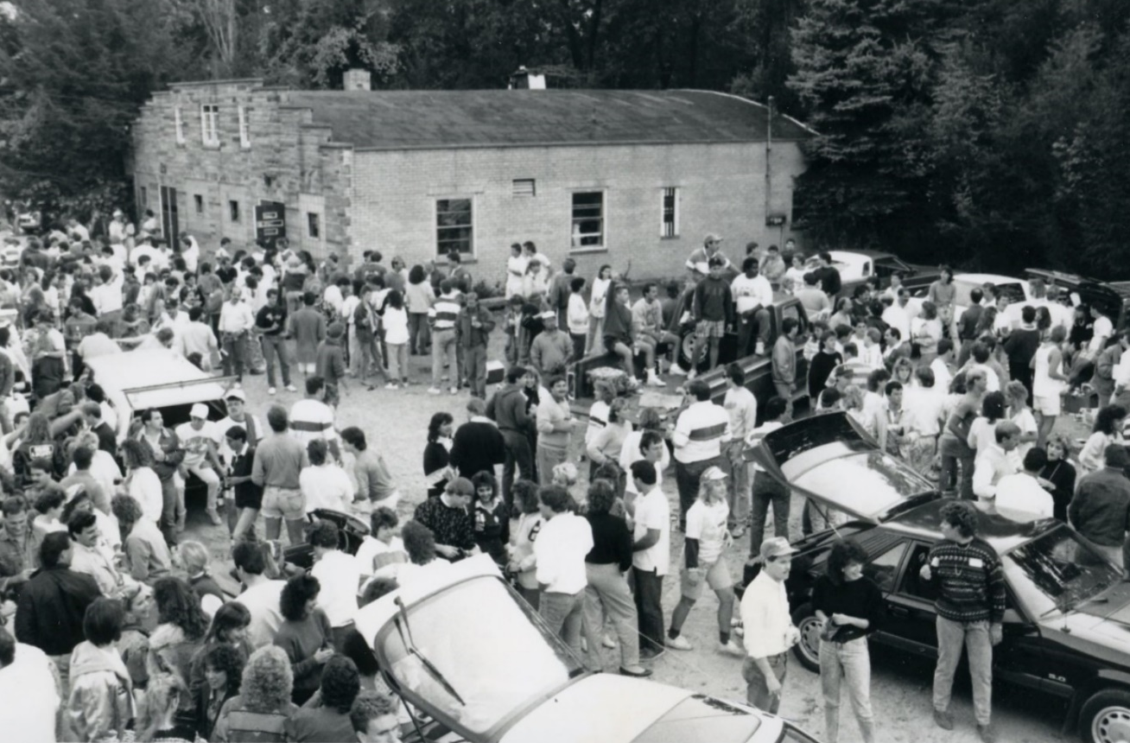
Who uses the Archives?
Legacy Students
See how their parents/grandparents lived at SRU

Slide 6
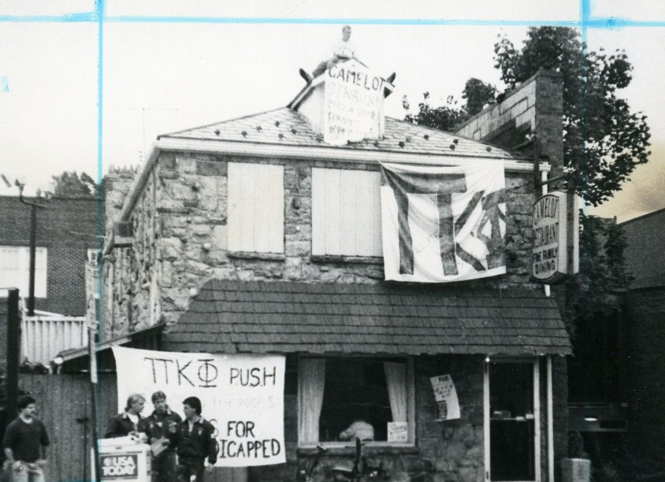
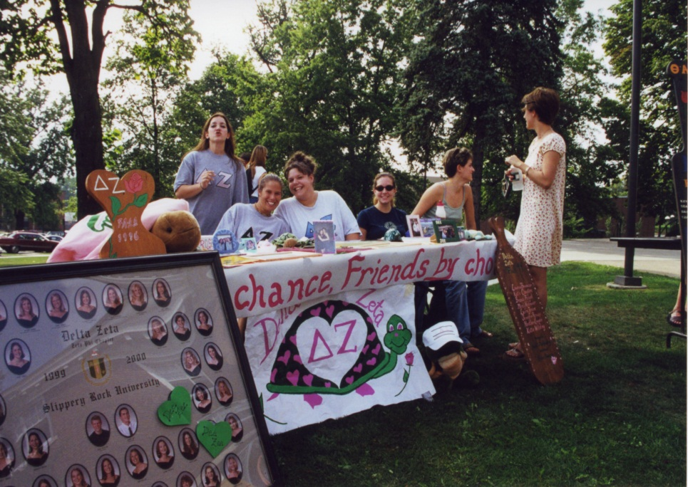
Who uses the Archives?
National Organizations (Greek, professional, service)
Past accomplishments
Research prominent alumni

Slide 7
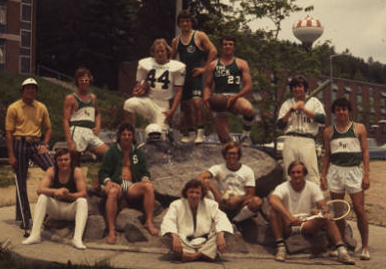
Whose records can be preserved?
ALL student organizations
Academic
Social
Athletics (NCAA, Club, and Intramural)
Student Media (WSRU-FM, WSRU-TV, The Rocket)

Slide 8
Whose records can be preserved?
Academic Departments
Including publications and performances by and for students, faculty, and staff
Administrative Departments
Finance, Public Affairs, Board of Trustees
CSIL, Career Services, Residence Life

Slide 9
What types of items are preserved?
This display, located in the first floor lobby, shows examples of records that are preserved by the University Archives. These displayed items generally represent the previous 30 years, but the Archives maintains records “from 1889 to yesterday.”

Slide 10
What types of items are preserved?
Documents
Minutes, Constitution, History, Pamphlets, Event Programs
Paper and Digital
Photographs
Formal and Candid
Scrapbooks
Audio & Video
Events and Performances

Slide 11
What items are not preserved?
Active Records
Archival storage is not temporary
Identifiable student records
Individual grades and finances are maintained by the appropriate offices, not the Archives
Individual Transactions
Annual budgets are sufficient

Slide 12
What can organizations do?
Sort through your inactive records
Make a list of what you would like to donate
Example: Meeting Minutes 2005-2007
Or: Photos 2010-2015
Awards Banquet
Initiation
Make an appointment with the Archives to discuss the donation process
Repeat frequently!

Slide 13
Contact us
Let us know you’re dropping by
Email: rockarchives@sru.edu
Web: http://sru.libguides.com/archives
Phone: 724.738.2635

